Slide 1
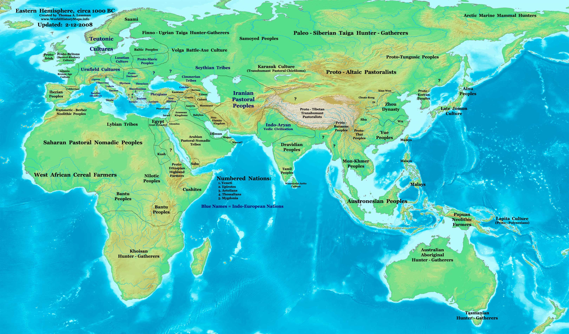
Decline of Empires

Slide 2
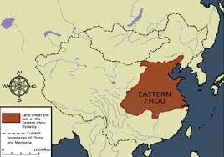
Eastern Zhou Dynasty
By 722 B.C.E. the power of the royal family was weakening due to wars and internal issues
Regional lords gained more power
Regional lords battled each other from 403 to 221 B.C.E. for power during the “Warring States” period

Slide 3
Four Great Systems of
Thought and Religion
Chinese Philosophy – includes Confucianism, Daoism and Legalism
Indian Religion – includes Hinduism, Jains and Buddhism
Hebrew Monotheism – includes Christianity and Islam
Greek Philosophy – beginning of intellectual thought, science and philosophy

Slide 4
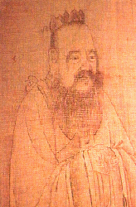
Confucius
Born in 551 B.C.E. to a lower noble family in northeastern China
A teacher and scholar
Lived during the later part of the Spring and Autumn Period of China
“Analects” are a collection of his teachings written by his disciples
Died in 479 B.C.E.

Slide 5
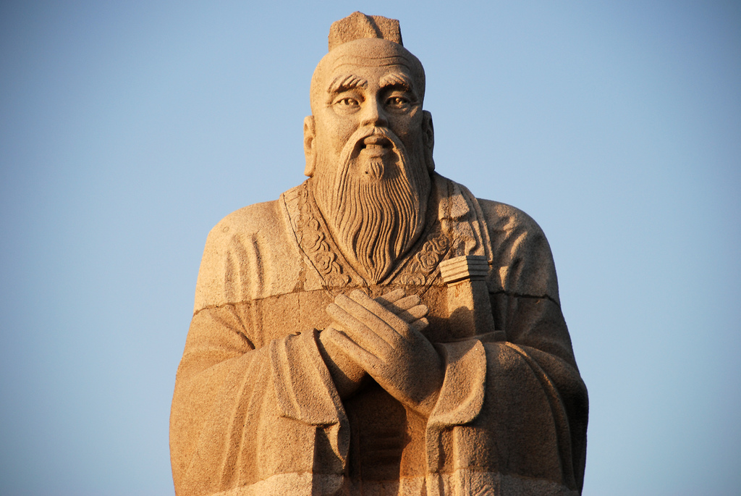
Teachings of Confucius
Sought social harmony
Rulers should treat people with kindness, respect and love
People should respect their rulers as they do their parents
Believed in the natural goodness of human beings

Slide 6
Teachings of Confucius
Believed that evil was a result of the breakdown of the feudal system
People should treat others as they would like to be treated
Believed good government requires good men
Believed correct behavior would bring order and stability
His teachings were ignored while he was alive

Slide 7
Confucianism Today
Over 6 million followers in the world
99.4 percent are in Asia
Primary followers are in China and Taiwan
Korea has the largest population of followers outside of China
Followers also present in Japan and Vietnam
“Life is really simple, but we insist on making it complicated”

Slide 8
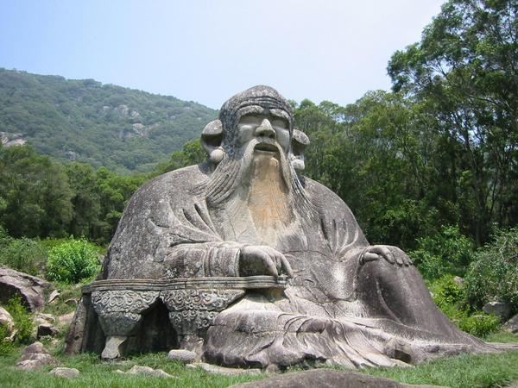
Laozi
Born in the 6th century B.C.E.
A contemporary of Confucius and believed to be his teacher
A scholar and writer
Work as the Keeper of the Archives for the Zhou royal court
Died in 531 B.C.E.

Slide 9
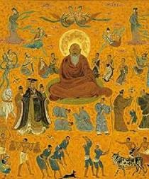
Daoism (Taoism)
Founded on the teachings of Laozi
Author of the Tao Te Ching
Explained his teachings through paradox, analogy, repetition, ancient sayings and rhyme
Focuses on the individual and spiritual life

Slide 10
Teachings of Laozi
Promoted the “Dao, ” or way
Promoted a simple life without desires
Believed knowledge interfered with the Dao
Life and death are two aspects of reality; the yin and yang
Death is simply a transition from being to non-being
Does not emphasize rigid rituals and social order

Slide 11
Daoism Today
About 20 million followers in the world
There are about 30,000 followers in North America
Primary followers are in China and Taiwan
Many practice in conjunction with Confucianism, Buddhism and other religions
1 of the 5 religious doctrines officially recognized by the People’s Republic of China and Taiwan

Slide 12
Eastern Zhou Dynasty
The period of 771 – 476 B.C.E. is known as the Spring and Autumn of the Zhou dynasty
Last attempt of Zhou rulers to consolidate and centralize their power
Made governmental reforms in the regions they controlled
Created a system of registering peasants for tax purposes and army conscription

Slide 13
The Warring Years (481 – 221 B.C.E.)
Each state relied a core of professional troops supported by conscripted peasants
Armies used iron armor, weapons and crossbows
Large state armies contained nearly 1 million men
Agricultural revolution in the Yellow River Valley led to an increase in the population

Slide 14
Zhou Agricultural Revolution
Regional lords allowed peasants to own land in return for taxes and military service
Introduced new technologies, such as crop rotation, canals and irrigation systems
Wheat, millet and rice were the main staple crops grown
The population increase led to diminished resources

Slide 15
Decline of the Zhou
Continued conflict and warfare between the seven states weakened the power of the king
Power became more focused with regional lords instead of the king
People looked to the local lord rather than the king for protection
In 256 B.C.E. the army of the Qin captured the city of Chengzhou and King Nan was killed

Slide 16
The Upanishads
A later Vedic text promoted from 800 – 500 B.C.E.
Place a new emphasis on knowledge over ritual practices
Presented immortality as an escape from existence
Centered on the nature and mental actions of the individual

Slide 17
The Upanishads
Believed the “samara,” or cycle of life and death, was never ending
Created the concept of “karma” to counter the samara
Emphasized good deeds over bad deeds
The concept of “dharma” gave acceptance to the actions of individuals

Slide 18
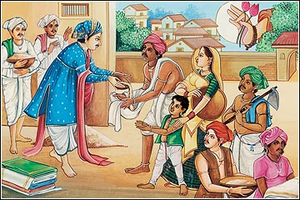
Old Classes, or Varnas
The Brahman priest interpreted the Vedic text for the commoners
The Kshatriya, or warrior class, was the nobility or ruling class
The commoners
The laborers
Each “Janis”, or sub-class was divided

